Slide 1
NC Department of Health and Human Services
Fall 2019 LME/MCO Provider Meetings
August 12th – August 22nd , 2019

Slide 2
AGENDA
Welcome/Introductions
State Updates
Grants and Funding
PFS 2018, PFS 2019
State Opioid Response (SOR)
Synar Pilot Extension
FY 19 Pilot Audit Findings
FY20 Audit Process
Trainings for Providers, LMEs-Coming Soon
Needs Assessment- Submission in July 2020
Training TBD
Master Reach
Synar: ECCO Updates
TTA Updates
Questions and Answers
Notes:
Striving to accurately capture the work done across the state for better strategic planning of merchant education efforts
Imperative to limit data errors

Slide 3
State Updates

Slide 4
Partnerships for Success (PFS-2018)
Primary prevention initiatives focused on utilizing a strategic planning process to prevent underage alcohol use by youth ages 9-20, marijuana and e-cigarettes
10 counties will be awarded up to $123,000 annually to plan and implement evidence- based prevention initiatives for:
Alcohol OR
Alcohol and marijuana OR
Alcohol and e-cigarettes

Slide 5
PFS-Community Request for Applications (RFA)
RFA SCHEDULE
Date | Event
07/19/2019 | Request for Application posted
08/26/19-10 am-noon 08/27/19-1-3 pm 08/28/2019-1-3 pm | Information Webinars (same content on each day/time)
09/06/2019 | Last Day for Emailed Questions
09/13/2019 | Responses to Questions, General Clarifications Posted
09/20/2019 | Applications Due by 5:00 pm
09/30/2019 | Notification of Selected Applicants
After 9/30/2019 | Applicants Awarded funding

Slide 6
PFS 2019
North Carolina applicants should receive notification soon
Nationwide:
Approximately 127 grants and 25 tribes awarded
Check this website for more information:
https://www.samhsa.gov/grants-awards-by-state

Slide 7
State Opioid Response-Supplemental
July 1, 2019-June 30, 2020 (work completed through federal fiscal year-September 30, 2019)
Funding awarded to:
Build opioid prevention response in local coalitions through CINC
Pilot project in Western part of state for alternative pain management

Slide 8
Synar Pilot Extension
One time allocation extended through the LMEs to providers
Invoicing- September 30, 2019
Pilot Extension Work- December 31, 2019
Notes:
Process for one time allocation:
State sends invitation for request to LME
LME responds to state
State sends MOU to provider
Provider sends signed MOU back to State
State approves and provider uses MOU as scope of pilot extension work
Process for Invoicing
Invoice LME for entire allocation by September 30, 2019
Complete pilot extension work no later than December 31, 2019

Slide 9
Maximum Allocation- up to $75,000
Topic 1: $30,000-Tobacco retailer work
Topic 2: $25,000-Tobacco survey work
Topic 3: $20,000-Vape Shops and/or Kratom/CBD store work
Notes:
Topic 1: $30,000 (must choose one of the first two bullets at minimum)
Tobacco retailer work
Conduct merchant education for 90% of tobacco retail outlets in a given area, (zip, city, county, census tract/block, etc.).
Complete coverage study of selected zip codes (training/webinar provided) to verify accuracy and coverage of tobacco retailers in current merchant list.
Publicize positive merchant efforts (i.e. local media, congratulation letters, merchant pledges, materials-button or lapel pins, etc.)
Recruit/retain/pay youth volunteers for work and/or supplies, as necessary (i.e. merchant education, coverage study, media work, etc.)
Pay personnel/staff for time and travel
Topic 2: $25,000 (must choose first bullet at minimum)
Tobacco survey work
Conduct tobacco surveys (non-enforceable compliance checks), for tobacco retailers with FDA violations, using youthful looking 18-year old young adults (training/webinar provided) *no law enforcement required
Publicize positive merchant efforts (i.e. local media, congratulation letters, merchant pledges, materials-button or lapel pins)
Recruit/retain/train/pay young adult volunteers for work and/or supplies needed (i.e. tobacco survey, media work)
Pay personnel/staff for time and travel
Topic 3: $20,000 (must choose one of the first two bullets at minimum)
Vape Shops and/or Kratom/CBD store work
Conduct Environmental scans of Vape Shops
Conduct Environmental scans of Kratom/CBD stores -*does not count towards Synar
Publicize findings (i.e. local media, city council meetings, etc.)
Recruit/retain/pay youth volunteers for work and/or supplies as needed (i.e. environmental scans, media work) *youth not required for environmental scans
Pay personnel/staff for time and travel

Slide 10
Synar Pilot Extension
Allowable Expenditures
Not Allowable Expenditures
Travel, hotel and mileage for staff (for work and trainings)
Materials (for merchant education, tobacco survey and media publicity items)
Young adult volunteer time (for tobacco surveys, environmental scans etc.)
Light snacks for Young adult training/work (up to $3.00 per person per event)
Indirect costs (up to 10% per agency)
Law enforcement time
Indirect costs/fees that puts the total amount OVER what was originally requested
Can’t receive $33,000, $55,000 or $82,500 in funding
No purchase of tobacco industry materials (WeCard etc.)

Slide 11
FY19 Audit Findings

Slide 12
Themes
Materials were thorough, need time in advance to prepare
Helped connect ECCO, guidelines to prevention work
Need reporting screens, improvements in ECCO
Highlighted areas in ECCO that need more attention
Enter Process Evaluation
Synar
Helps with standardization in audits-Less Paper!

Slide 13
Audit Process-FY20

Slide 14
FY 20 Audit: April-June 2020
Education and Environmental Strategies/interventions ONLY
ECCO-based
Progress toward strategies/interventions
Findings will be educational
Referral to additional resources, training/TA
Training and TA for LME/MCOs and providers prior to audit

Slide 15
At-A-Glance FY20 Audit Process
Pre-Audit
Audit
Get tools (after August LME/MCO meetings)
Update ECCO (monthly is recommended to assist with audit/reporting)
Receive training/TA as needed
Work with LMEs-Pre-Audit meetings (as determined by LME)
Desk audit by State Team (Prevention staff)
Provider interviews
Face-to-face audit review meetings with LME/providers
Recommendations (Strengths/Areas for Improvements)

Slide 16
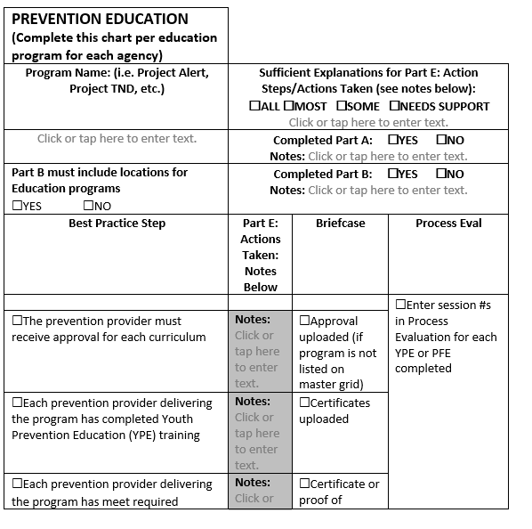
Audit Tool
Complete in ECCO:
Part A (General Info)
Part B (Intervention Info)
Briefcase document uploads
Part E (Action Plan)
Process Evaluation
For each ENVIRONMENTAL and EDUCATIONAL strategy

Slide 17
Progress (toward best practice steps/ guidelines/standards)
Meet minimum progress for at least 2/3 of the total environmental and educational intervention/strategies per agency
Each intervention/strategy has different progress
YPE-complete planning/implementation for one class per fiscal year
School Policy-complete planning steps in fiscal year
Take Back Events-complete planning/implementation for 1 event per fiscal year
Some things are out of your control, so documentation in action steps is crucial!

Slide 18
What if I Don’t Make 2/3 Progress?
During the audit, the state audit team will make recommendations for:
Discontinuation of the intervention (depending upon the likelihood of overcoming barriers and/or the degree to which the barriers can be controlled by the provider)
Technical assistance/resources in overcoming barriers to making progress
May be a plan of correction in future audit years (FY 21)

Slide 19
Timelines: LME Audit Training
August Introduction to FY20 Audit Process/Tools at LME/MCO Meetings
November
LMEs can schedule individual training
December
General Overview Webinar for All LMEs
October
LMEs can schedule individual training

Slide 20
Timelines: Provider Audit Training
January-mid-February: Providers can schedule Audit Prep meetings with TA
March-April- LME Review
April-June: FY20 Audits w/State Team
End of February-Face-to-Face Audit Training and/or Overview Webinar for all Providers

Slide 21
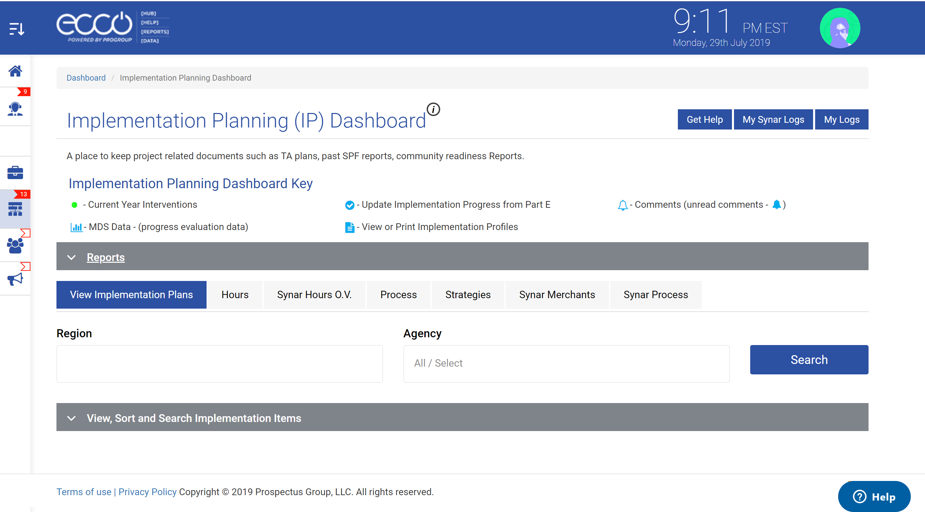
ECCO Improvements for Audits-Reports!

Slide 22
ECCO Improvements for Audits-Reports

Slide 23
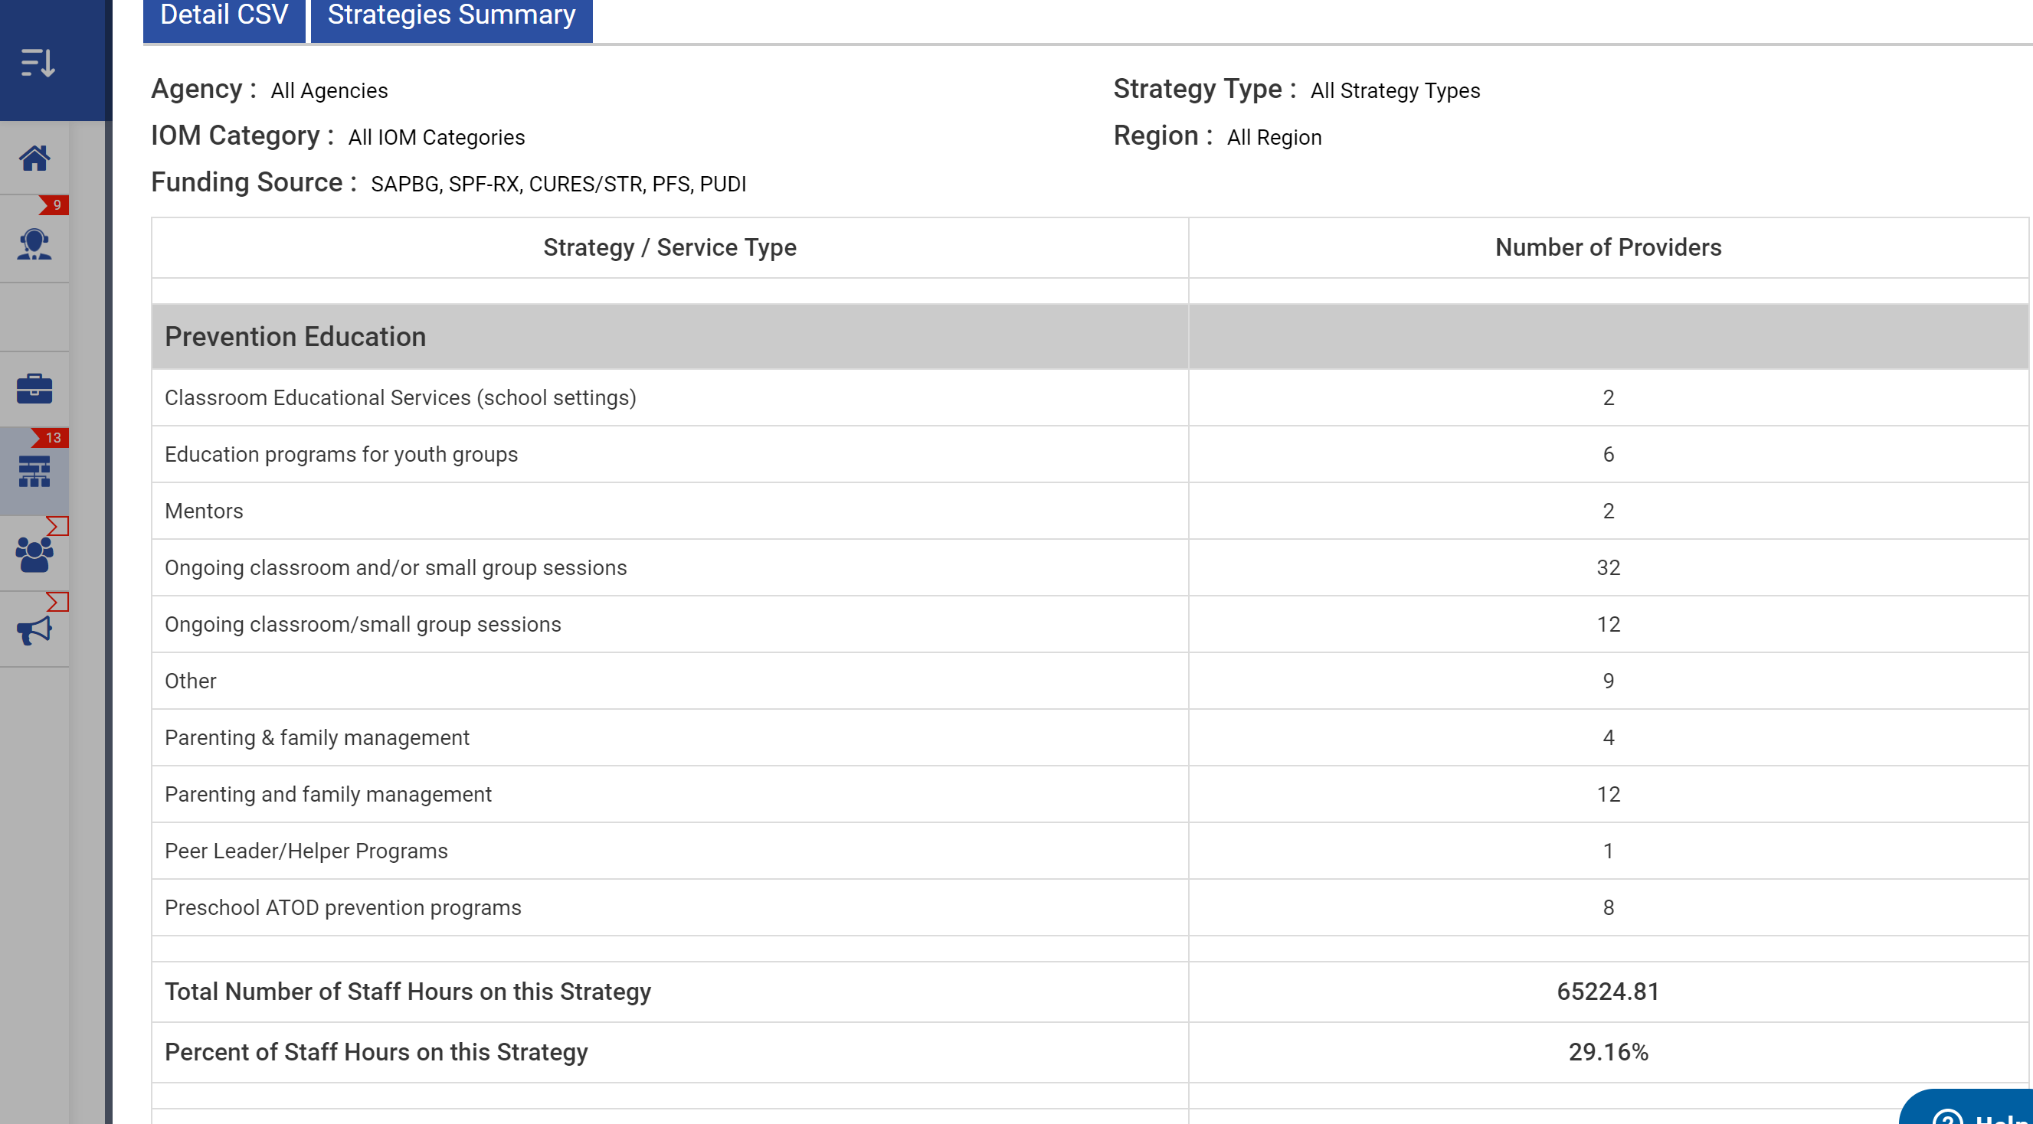
ECCO Improvements for Audits-Reports

Slide 24
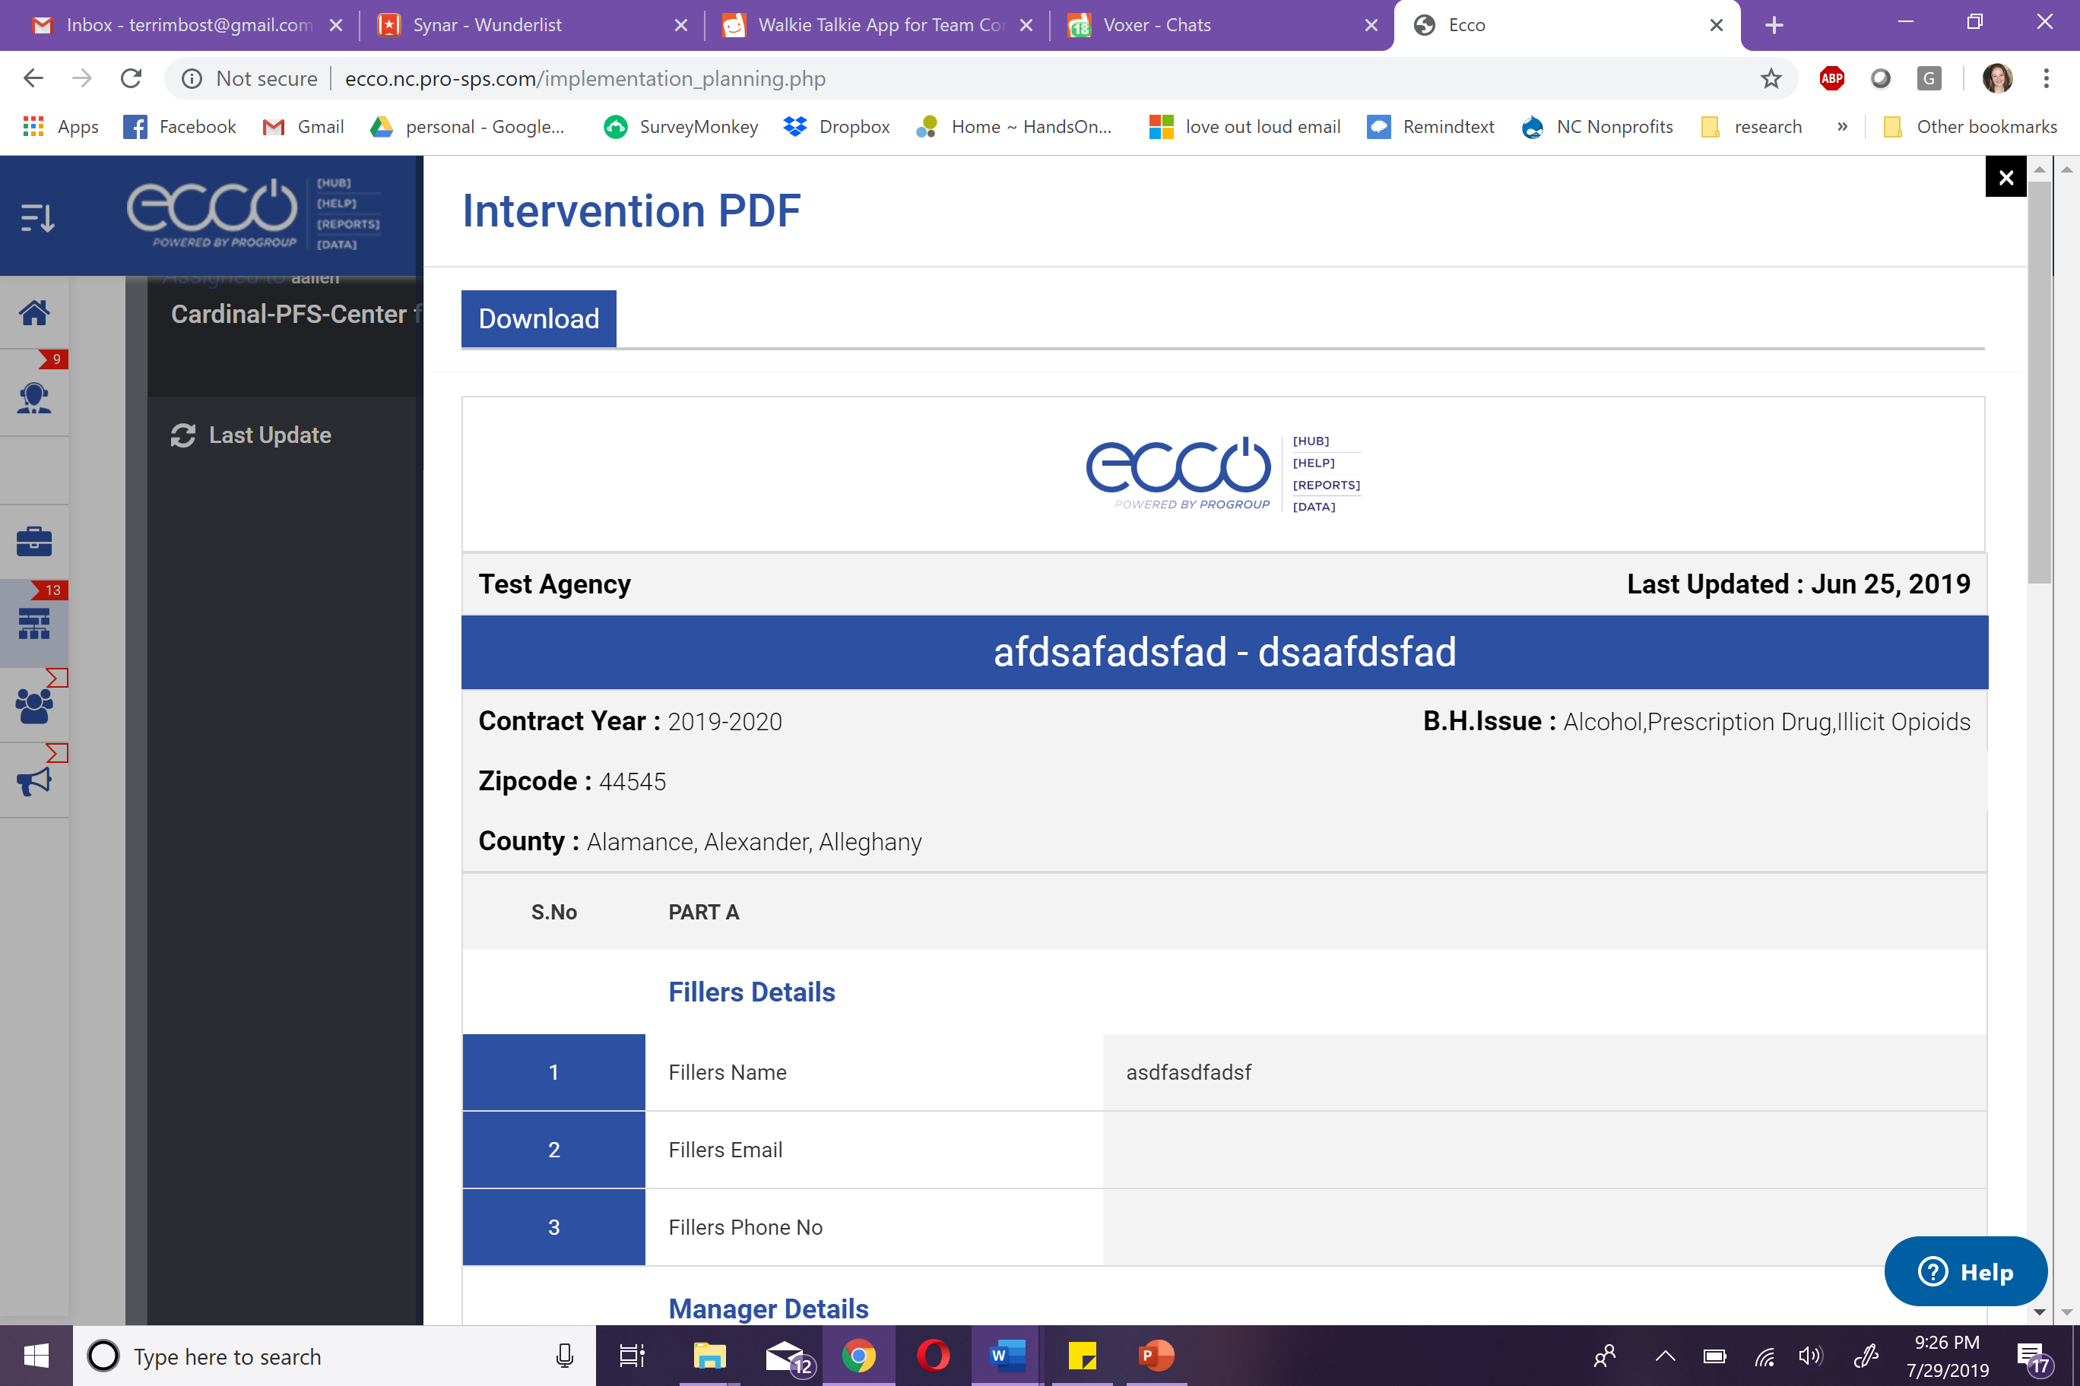
ECCO Improvements for Audits

Slide 25
ECCO Improvements for Audits: Action Plan

Slide 26
Needs Assessment
Master Reach

Slide 27
Synar: ECCO Updates

Slide 28
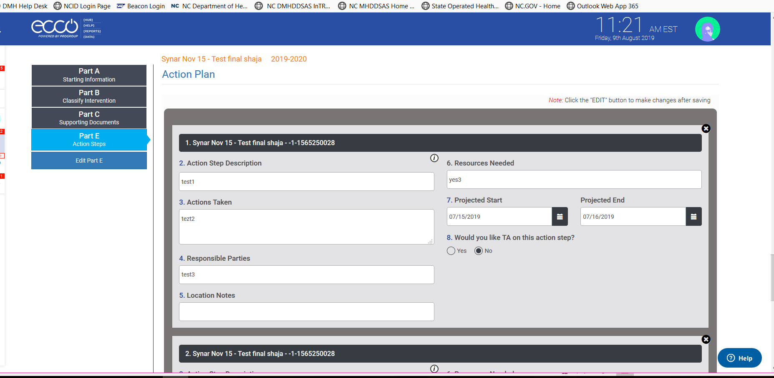
Synar: ECCO Updates
Part E-Action Steps
Notes:
New this year, you will only enter action planning steps for Law Enforcement and Media. We are not requiring you to enter action steps for Community Mobilization and Education or Merchant Education because we can see your progress on these in process data and the merchant tracker.

Slide 29
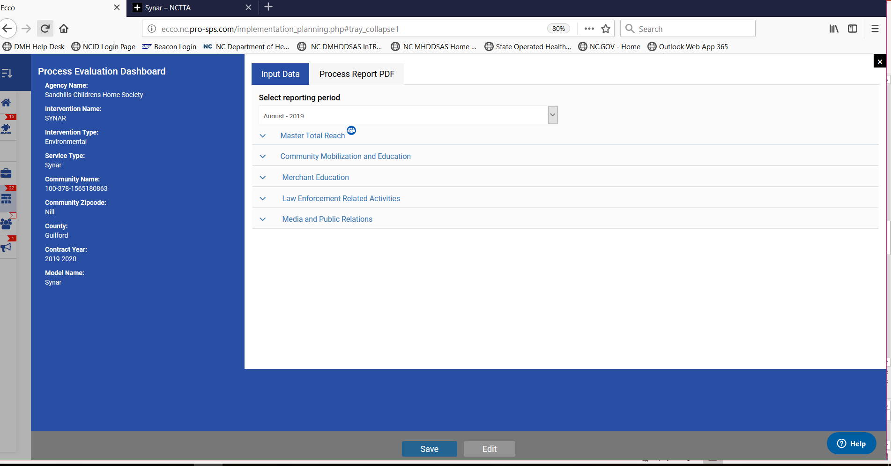
Synar: ECCO Updates
Process Data
Notes:
Just like Melinda explained, you will enter master reach for Synar in the process data section shown above.
Moving forward, there are only 2 instances where you should be entering information for master reach for Synar on a monthly basis. The first is when you have administered merchant education for 90% of retail establishments in a given area (zip, city, county, census tract/block, etc.) In the meantime between covering 90% of a catchment area, you may count the number of adults (i.e. # of new store clerk/managers, #new adult volunteers). Remember not to count any individual more than once per year.
Community Mobilization and Education- remember you will only answer yes to these questions if these are meetings specific to Synar around tobacco enforcement and/or youth access. You should not report under this section if you attend a meeting for general tobacco prevention or education.
Merchant education- We took out the identification of retail outlets tab and now there are just 2 tabs. You will click the merchant education tab if you, as the provider, are conducting merchant education. If you use youth to do merchant education you will click on community youth group partnerships and then question 12 will appear that will ask you to name the specific youth group that you partnered with.
Law enforcement and media are still the same. No changes have been made.
Reiterate that they should report process data each month if applicable. Hit edit first to enter data.
Information regarding counting master reach for Synar below:
Only capture participants once in master reach. If you have multiple interactions with the same person in a given month or in subsequent months you will only count them one time for the entire contract PERIOD FOR EACH INTERVENTION. ALL ACTIVITES UNDER SYNAR COUNT AS ONE INTERVENTION, therefore, if they have already been counted in FOR A SYNAR ACTIVITY do not COUNT THEM FOR SUBSEQUENT Synar ACTIVITIES.
Fill in NEW participants reached each month for merchant education visits and compliance checks by counting the number of clerks, managers, etc. that you interact with during the intervention. You will only count participants at coalition meetings if the meeting is specific to Synar. If you visit all the merchants in a particular zip code, CITY, OR county, you will use the census reach tool to estimate total impact for 12-17 year-olds once per contract year. THEIR REACH SHOULD BE COUNTED IN THE MONTH YOU WORKED WITH THE LAST MERCHANT IN THE ZIP CODE, CITY, OR COUNTY.
It is recommended that agencies comprehensively cover a county, city, or zip code (or smaller census unit) before moving to the next so that they can count all the 12-17 year olds in that census unit. You may include the activities of adult volunteers and youth group in calculating reach. If you serve a metropolitan area and need to estimate down to census tracks or block groups, use the Census Interactive Population Map to get population estimates and identify boundaries. https://www.census.gov/2010census/popmap/

Slide 30
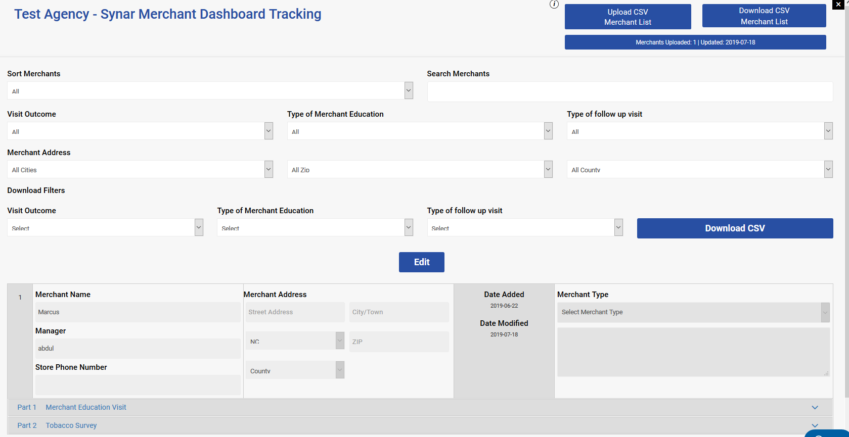
Synar: Merchant Tracker
Notes:
As you can see there are several new features on the merchant tracker dashboard. We have updated the forms for Part 1 Merchant Education Visit and Part 2 Tobacco Survey which directly correspond with the tracker. Go to the help desk and click on NCTTA and click on Synar and then go to Synar updates and protocols to see the Tobacco Survey form and the Tobacco Merchant Education form.
Go to merchant tracker in ECCO to demonstrate.
When trying to locate a specific store you have the following options to find on the dashboard:
Sort merchants
Search merchants
Visit Outcome
Type of Merchant Education
Type of follow up visit
Merchant Address
You can download and print off a CSV file now by filtering:
Visit Outcome
Type of Merchant Education
Type of follow up visit
There is also a blue edit button in the middle of page that you will need to click in order to edit any of the records on the dashboard. This was put in as a precaution because data was being imputed but not saved. Once you have found the store you wish to edit, you will make the changes and then click the green save button within the box to save the entry you are working on. This is with edits to old records as well as to new merchant education visits that you add.
There have also been changes made to the questions within Part 1 Merchant Education Visit. There is now
Visit Outcome and you will choose the following:
Visit Complete
Store Temporarily Closed
Store Out of Business
Store Moved
Store Refused
Unsafe Location
Other
Type of Merchant Education
Routine Visit: You will select this for the majority of your visits when you are delivering Red Flag packets
Manager Follow-up: You will select this when you are going back to the store because you weren’t able to speak to the manager on your first visit and you are not confident the clerk is going to give them the information
State Sign-Non Compliance: You will select this if you were going back to a store that you had selected state sign follow-up during a the previous visit
FDA Non-Compliance: You will select this type if you got this store off of the violations list on the FDA website

Slide 31
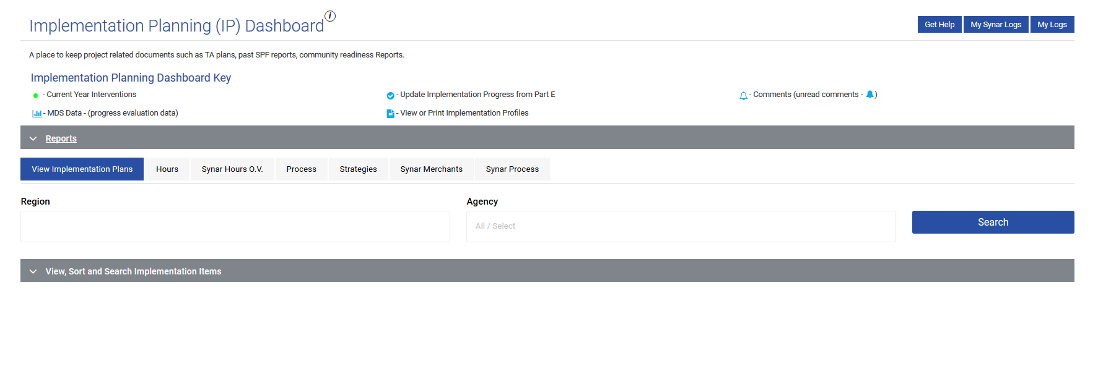
Synar: Downloading Reports
Notes:
There are now new features in the reports section of ECCO as it relates to Synar.
Go to ECCO and demonstrate pulling reports. Use an example provider for each LME.
All you have to do is click on whichever tab you want and choose your Agency and the Report From and Report To time frame. The other filters are not necessary unless you just want to click them.
Synar Hours O.V.- is used to view all of your hours for Synar in the following intervention categories:
Community Mobilization and Education
Merchant Education
Law Enforcement Related
Media and Public Relations
Synar Merchants-allows you to view a detailed CSV (excel spreadsheet) or a populations summary which is just a repeat of what’s seen on the dashboard, also an excel spreadsheet of your merchants which is also in the merchant tracker. This is our way to download reports and obtain a snapshot of what’s being done across LMEs and providers.
Synar Process- gives you the numbers for master reach for total age group counts, total racial category group counts, total race group counts and total gender counts. Detailed CSV and populations summary available for process.

Slide 32
TTA Updates

Slide 33
Q and A
This Photo by Unknown Author is licensed under CC BY-NC

