Slide 2
Training and Technical Assistance
Is designed to provide ongoing support to build the capacity of the prevention workforce to plan, implement, and evaluate evidence-based strategies to promote health status and reduce substance use and other behavioral health disorders.

Slide 3
Typical Goals of TTA
General workforce development
Development of specific competencies
Enhanced capacity to implement evidenced based prevention strategies
Supporting state and/or national certification requirements (NCSAPPB)

Slide 4
TTA Systems Can…
Help bridge the gap between research and practice
Provide support for evidenced based practices
Gather information on best practices for TA to ensure high quality support and quality training

Slide 5
Scaffolding TTA Practice
Distribution of Training Literature
Adult Learning Theory
Implementation Science

Slide 6
The Foundation of the NC TTA System
Collaboration
Encouragement
Trust
Autonomy
Support and respect
Rapport
Strength-based approach

Slide 8
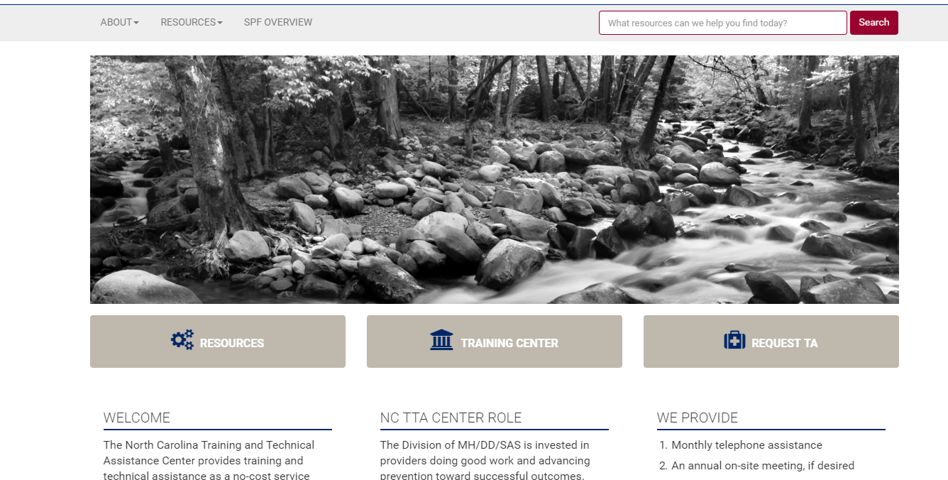
ncpreventiontta.org

Slide 9
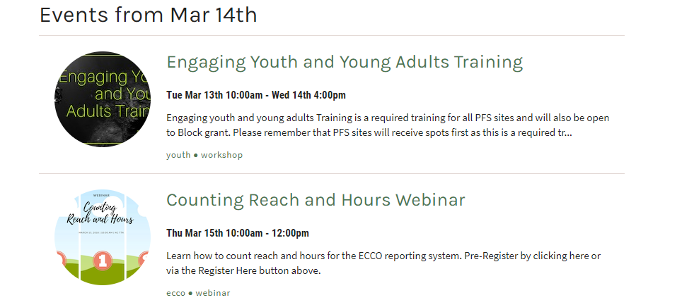
TTA Calendar

Slide 11
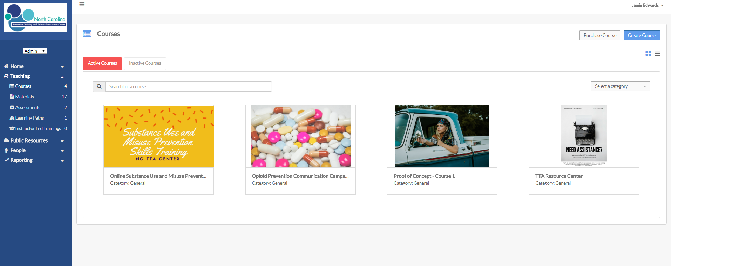
NCTTA Online

Slide 12
SUMPST: A Hybrid Approach

Slide 14
Social Media

Slide 15
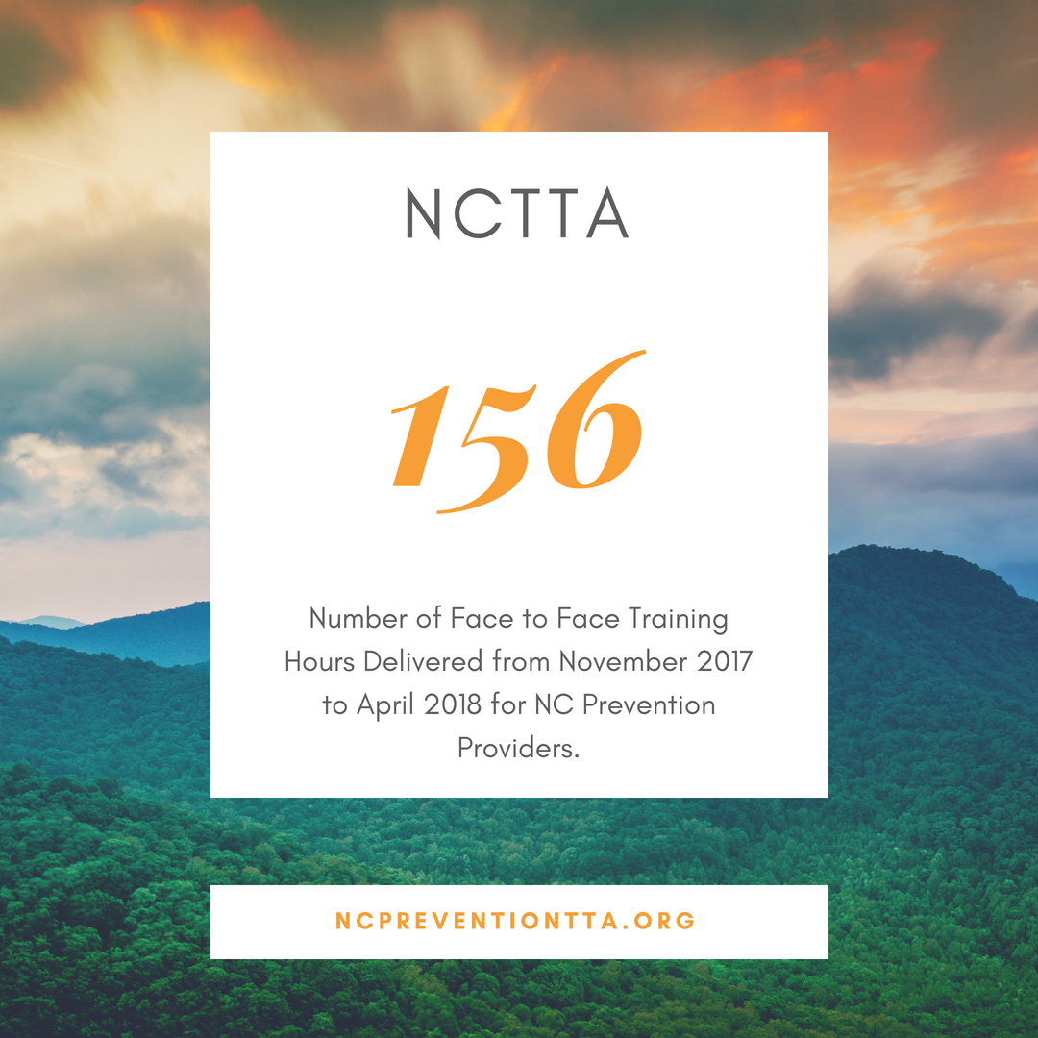

Slide 16
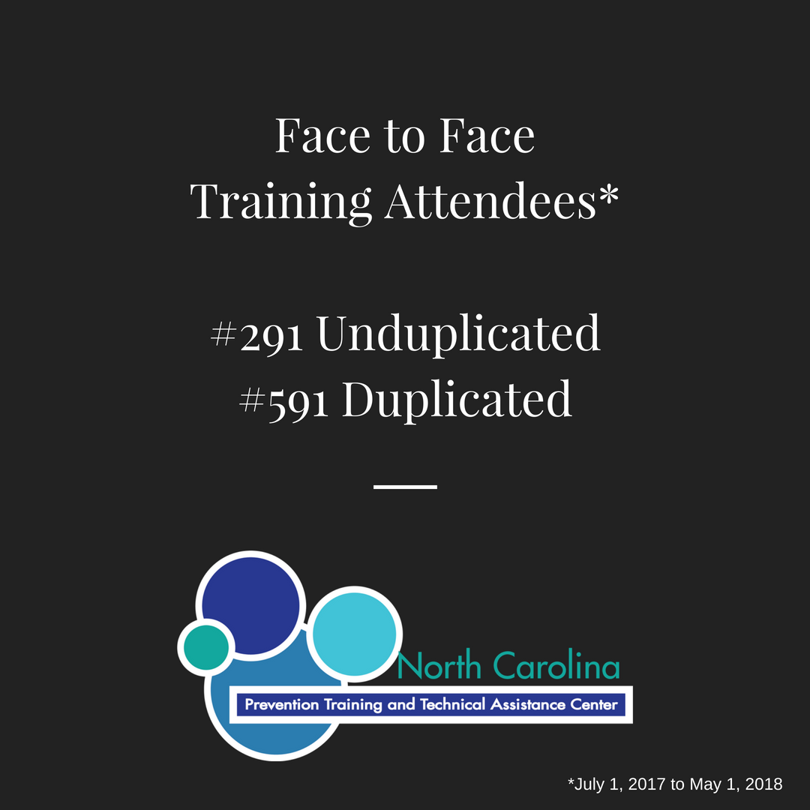

Slide 21
If you had one request for improving Training and Technical Assistance in the North Carolina Prevention System, what would you
ask for?

Slide 23
SYNAR
Look at revised Strategy Guidance Document for updated protocols for Merchant Education, Non-Enforcement Compliance Checks and Support for Compliance Checks
Merchant Education
Continue using the Excel spreadsheet
ECCO updates are being finalized
Use Merchant Education to also build a case for additional tobacco prevention work and increasing connections to local law enforcement
Consider Non-Enforcement Compliance Checks (if you see concerning issues such as stores selling loosies, no state signage in place, tobacco products by the checkout counter etc.)

Slide 25
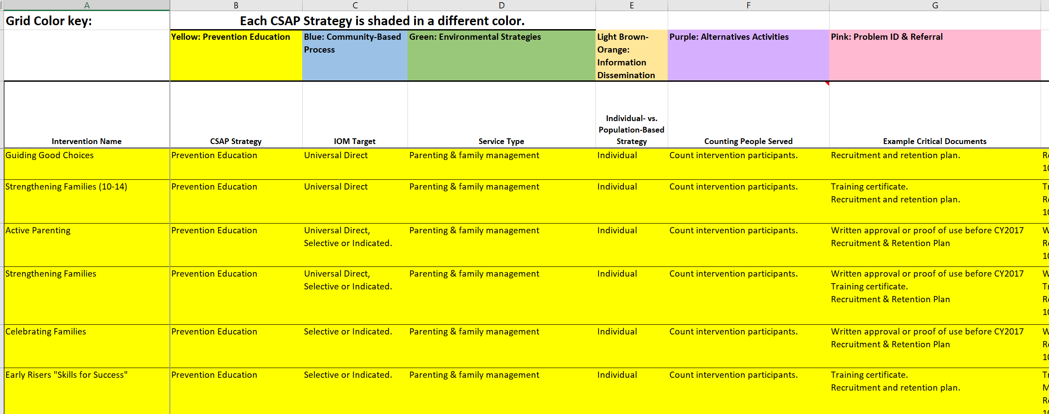
Master Grid
Feedback from provider focus group:
Too many interventions listed
Need specific examples per intervention
Reach (and impact of campaigns and some Tx drug strategies still confusing)

Slide 27
ECCO in FY 19
No 10 day turnaround per month as ECCO is still a work in progress. You can make changes after the 10th of each month, if necessary
Continue with Part A (System contact), B (categories found in master grid), C (uploading critical documents)
Some information will be hidden:
Community Readiness Score (Part A)
Social/Ecological Targets (Part B)
Risk and Protective Factors (Part B)
Part D (Implementation specific questions) and E (Action plans) are in progress
Entering FY19 Action plan into ECCO due date (to state) is late summer after TTA Center can provide ECCO training for:
Staff (who don’t enter ECCO information)
ECCO Designated Staff (more detailed ECCO information)
LME/MCOs-monitoring training TBD

Slide 29
2.5 Years in Review
Needs Assessment Data collection
Consumption and Consequence Data (what is the issue?)
Intervening Variables (why is it an issue in MY community?)
Prioritizing Intervening Variables (which issues should I work on first?)
Selecting Strategies/Interventions (What can I do to make an impact on issues?)
Effective Strategy/Intervention Grid (match intervening variables/substances to your community issue)
Magnitude (amount of use or misuse)
Readiness (staff and community)
Political will (support of key decision makers from agency/community)
Changeability (can something be accomplished by June 30, 2019?)
Action Planning (How do I describe what I’m doing [to LMEs and State]?)

Slide 30
The Past Five Months…
All the work you’ve done since January was intended to bring you to today
The TTA Center will continue providing constructive feedback about work you’ve done thus far so you can have a better final product
We’re all in this together and (some of us) are learning a new way of thinking, documenting and doing work
Mistakes will be made, but not trying to make changes is harder in the long run

Slide 31
Action Plans
You can use one intervention/strategy for multiple priority intervening variables
Don’t OVERDO it - consider your internal staffing and skill set when selecting strategies/interventions
Cut and Paste ”Best Practice Steps” from the Strategy Guidance document
Not every intervention/strategy can be completed in one year
Policy
Campaigns
Action plans are a living document and can be updated in ECCO
Location specific entry is in progress in ECCO
More training is coming in FY19

Slide 32
Remember to…and Common Themes
Cut and Paste from the Strategy Guidance Document (it’s a starting point, build off the foundation)
Who’s Responsible should include specific names when possible. Specific people, organizations or groups
Resources needed (can be monetary or in kind and include staff/human capacity), partnerships, agreements? A resource does not have to cost
Timeframe-be as specific as possible
At minimum list the month and year (ex. August 2018) – monitor open ended timeframes, establish benchmarks
Avoid empty columns
Avoid multiple actions in one step, break processes down
Remember your data and respective process that came before
Time invested in planning has a direct relationship to the quality program implementation

Slide 34
Action Plan Working Session
Take out your draft action plan and go through each strategy/intervention
Pay particular attention to:
Steps
Who’s Responsible
Resources
Timeframe
Ask us questions! We are here to help you improve your work!

Slide 36
Next Steps
Master Grid will be “downsized”
FY 19 ECCO Training is coming soon
Continue to enter hours, reach and Part A, B for new interventions
Some trainings will focus on interventions most people are doing via FY19 Action Plans
Synar
Prescription Drug Strategies (opportunities for peer sharing from PFS, SPF Rx and CURES sites)
Youth Environmental Management Strategies
Communication Campaigns

Slide 37
nctta@ncpreventiontta.org

